Slide 1
Behavioural classification of GPS locations using EMbC and HMM
Seabird Ecology Lab R Class
Sarah Saldanha

Slide 2
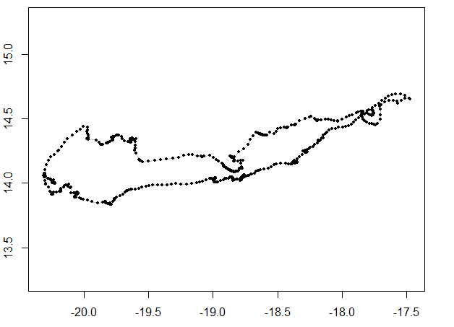
Behavioural annotation
Consecutive GPS positions give you:
Speed
Turning angle

Slide 3
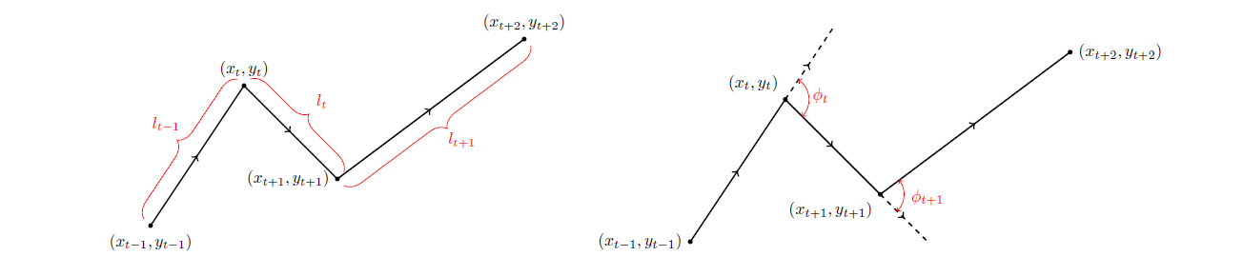
How do we define behaviours from tracking data?

Slide 4
Behavioural Annotation

Slide 5
Number of Behaviours
Will depend on the Species!
For seabirds:
2: Active and inactive
3: Rest, forage and travel
4:Rest, intensive foraging, extensive foraging and travel

Slide 6
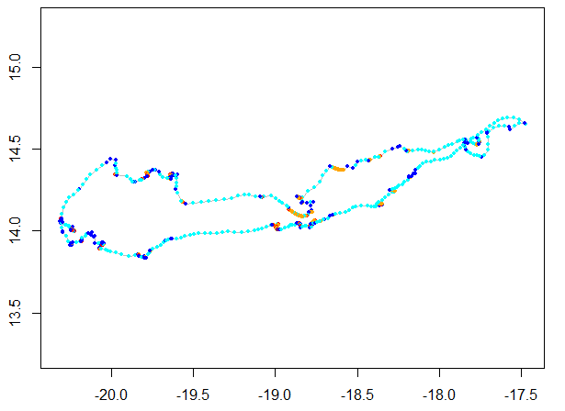
Behavioural annotation
Relocation
Resting
Intensive search
Extensive search
Notes:
Use an algorythm to group different speeds and turning angles that are believed to be associated with a behaviour.

Slide 7
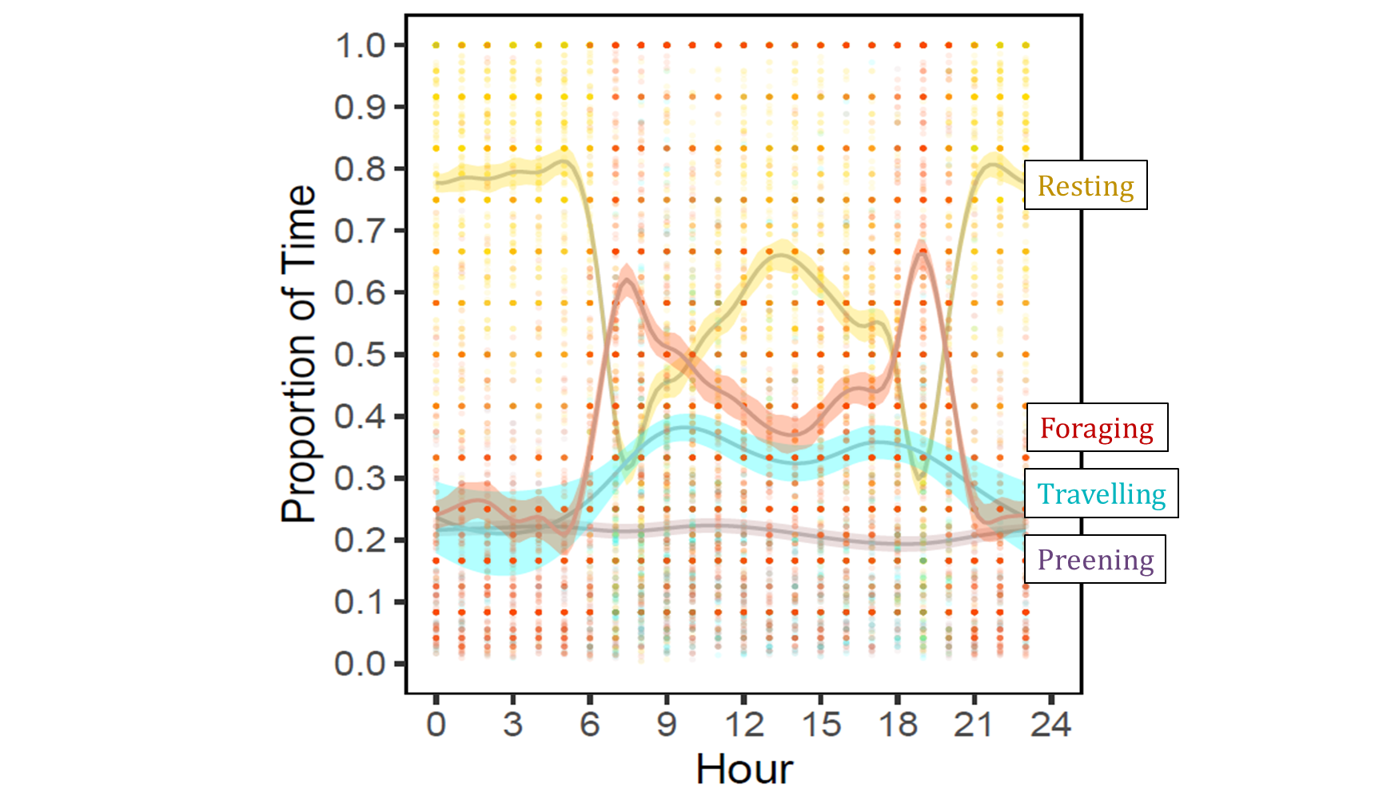
Uses

Slide 8
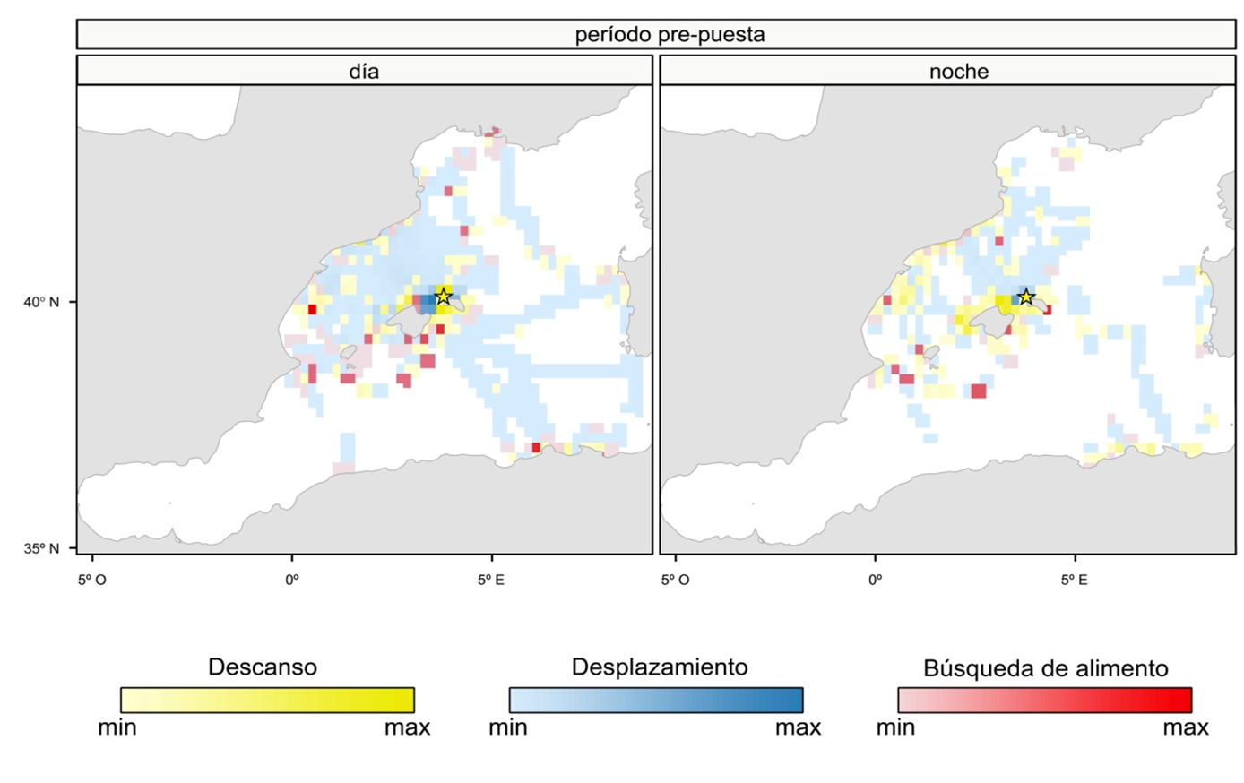
Uses

Slide 9
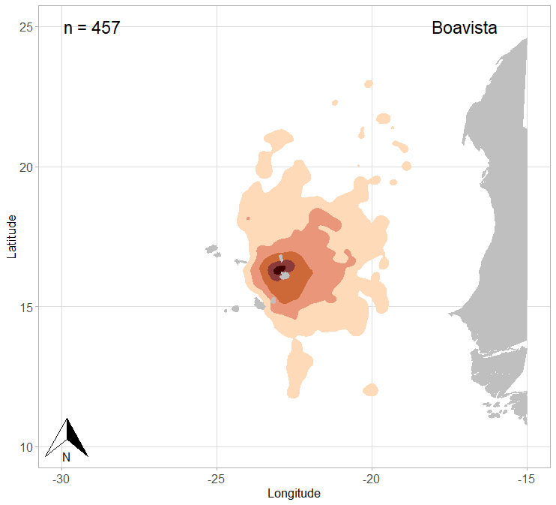
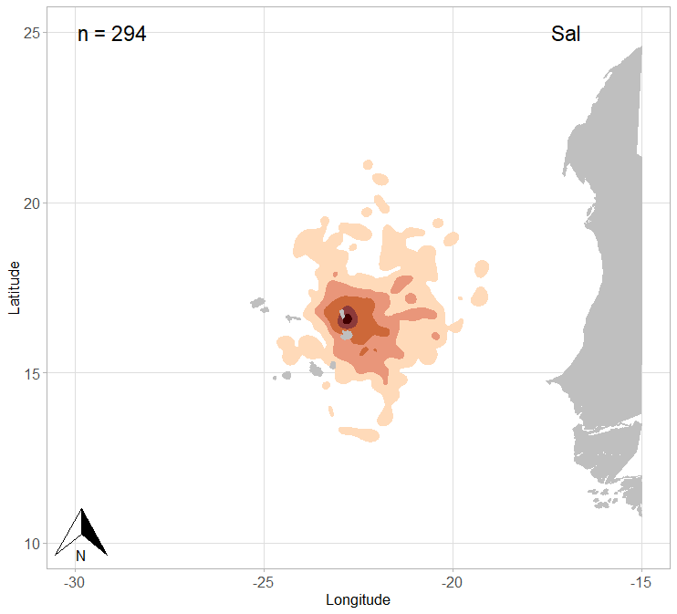
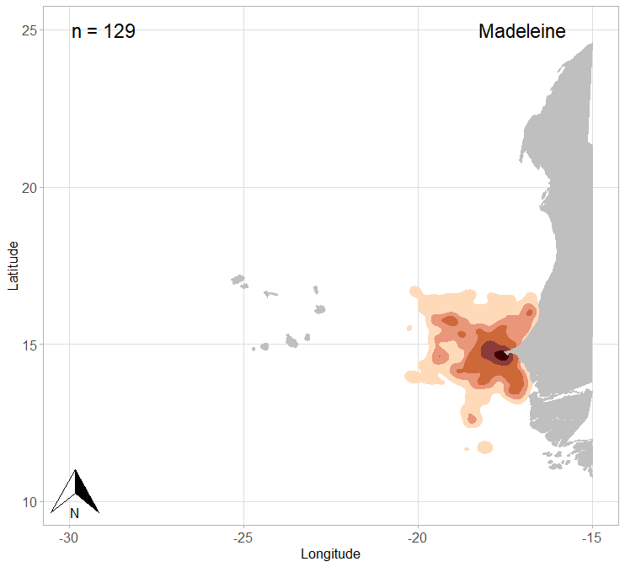
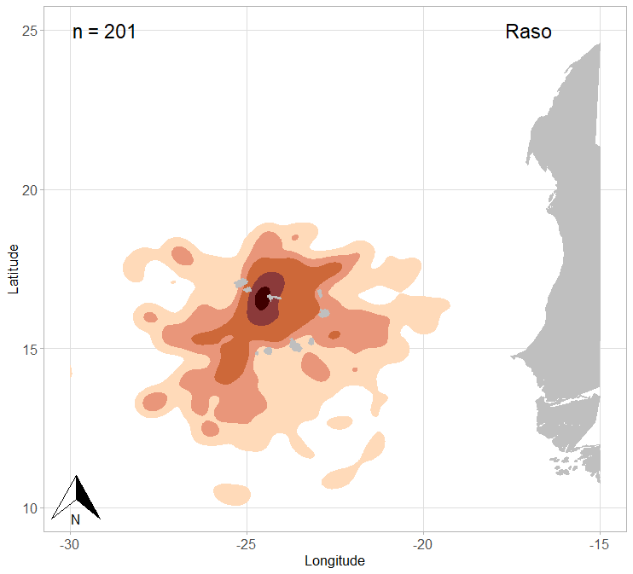
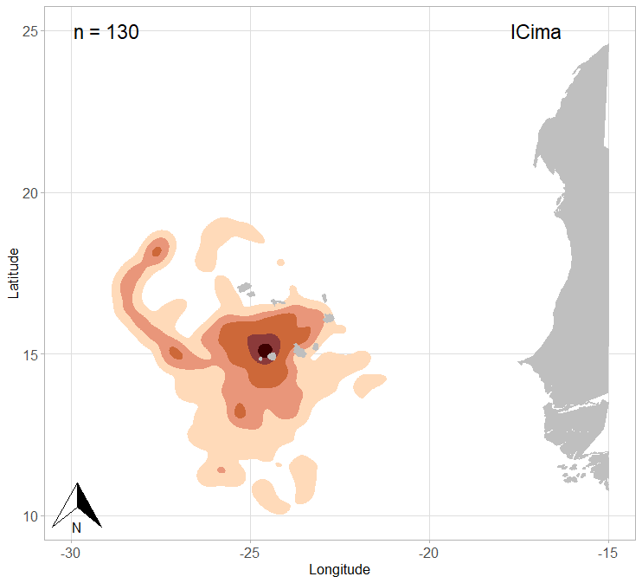
Uses

Slide 10
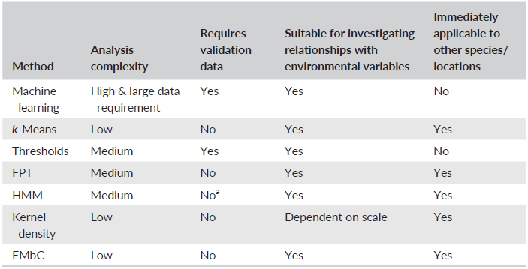
Behavioural annotation: which method?
Review comparing different methods to infer foraging behaviour:
Bennison, A., Bearhop, S., Bodey, T. W., Votier, S. C., Grecian, W. J., Wakefield, E. D., ... & Jessopp, M. (2018). Search and foraging behaviors from movement data: a comparison of methods. Ecology and evolution, 8(1), 13-24.

Slide 11
Behavioural annotation: which method?
EMBC
HMM

Slide 12
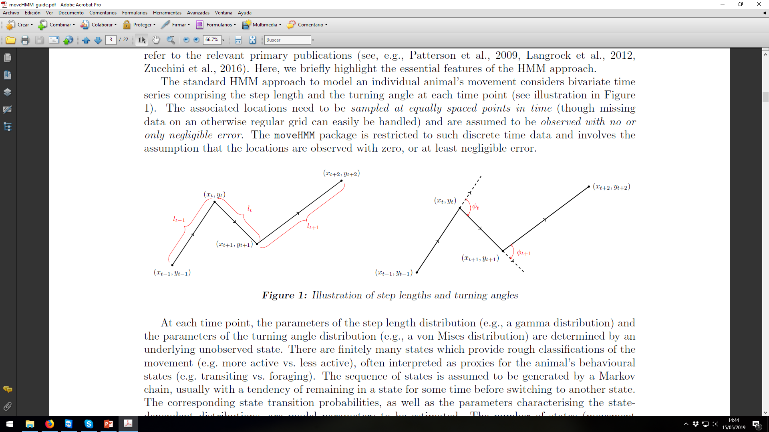
EMBC: Expectation-Maximization Binary Clustering
Compromise between statistical power and ease of use
Takes into account uncertainty of the data
Suitable for behavioural annotation of animals trajectories
Up to 5/6 input features -> 32/64 clusters (2^{m})
We use two imput features: speed and turning angle
Garriga, J., Palmer, J. R., Oltra, A., & Bartumeus, F. (2016). Expectation-maximization binary clustering for behavioural annotation. PLoS One, 11(3), e0151984.

Slide 13
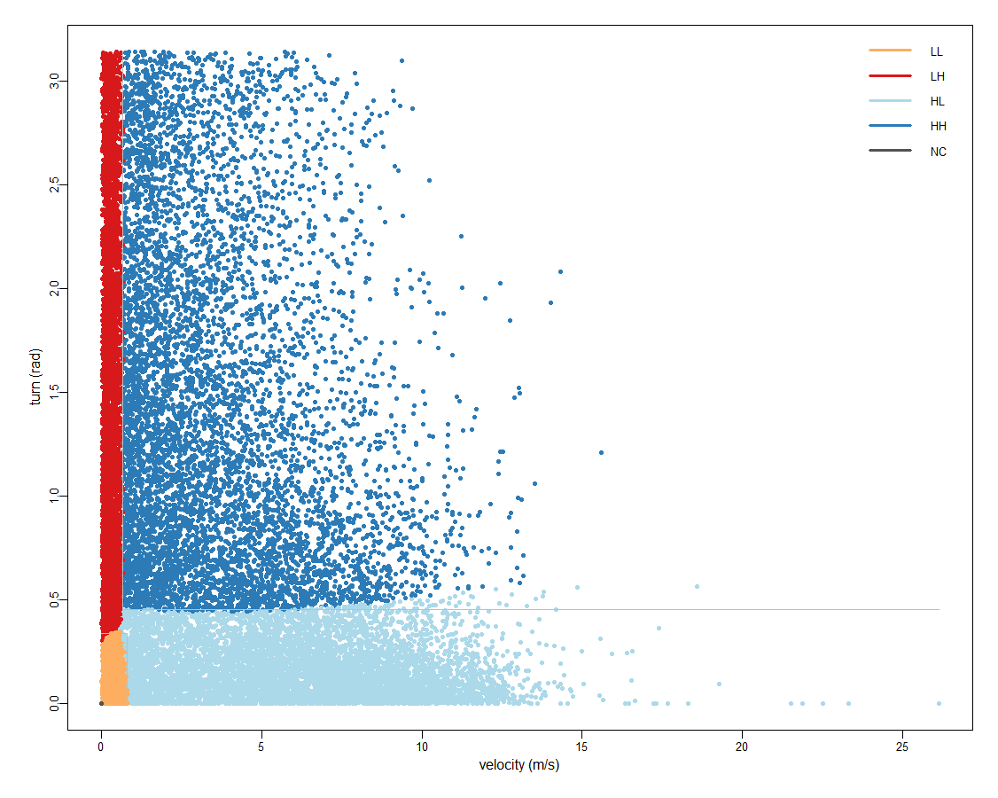
EMBC: Expectation-Maximization Binary Clustering

Slide 14
EMBC: Expectation-Maximization Binary Clustering

Slide 15
EMBC: Expectation-Maximization Binary Clustering
The number of output clusters is 2^{m} determined by the number of input features m.
Relocation
Resting
This number is only an upper bound as some of the clusters can vanish along the likelihood optimization process.
Intensive search
Extensive search

Slide 16
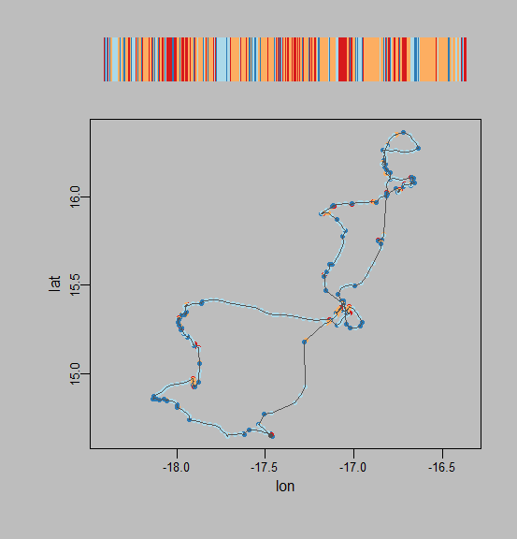
EMBC: Expectation-Maximization Binary Clustering
Smoothing
Without smoothig

Slide 17
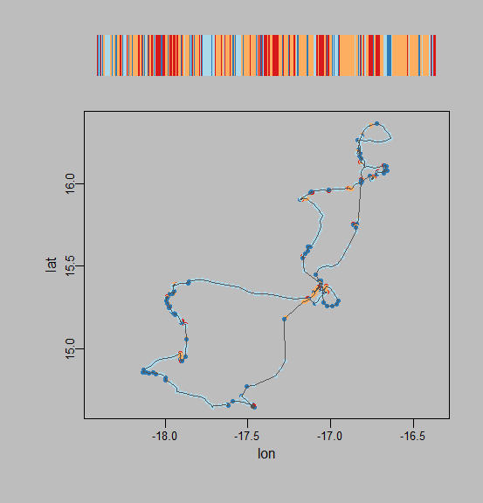
EMBC: Expectation-Maximization Binary Clustering
Smoothing
Without smoothig
With smoothig

Slide 18
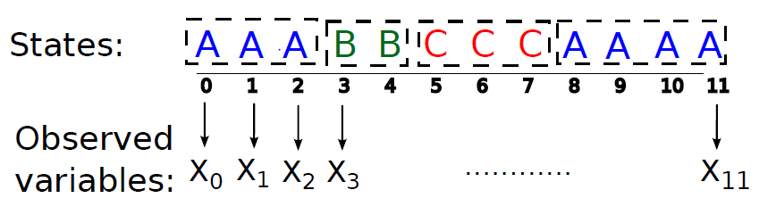
Hidden Markov Models
What are they?

Slide 19
Hidden Markov Models
What are they?
Most often used for tracking data now, but can also be useful for capture-recapture data
Observed: Number of birds recaptured
Hidden: recapture probability and survival probability

Slide 20
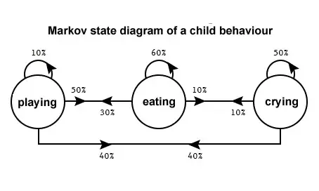
HMM
What are they?
Type of mixture model BUT with serial correlation (Markov Chains)

Slide 21
HMM
What are they?
Type of mixture model BUT with serial correlation (Markov Chains)
Assumption:
Given the present, the future is independent from the past

Slide 22
HMM
What are they?
Homogeneous if probability of changing from one state to the other is constant over time
All probabilities (between 0-1)
Sum row = 1
Reducible: prob. 0 can’t switch
Diagonal high: likely to remain in State

Slide 23
HMM
What are they?
Homogeneous if probability of changing from one state to the other is constant over time
All probabilities (between 0-1)
Sum row = 1
Reducible: prob. 0 can’t switch
Diagonal high: likely to remain in State
 | Resting | Foraging | Travelling
Resting | 0.8 | 0.1 | 0.1
Foraging | 0.3 | 0.6 | 0.1
Travelling | 0.15 | 0.05 | 0.8

Slide 24
HMM
Tendency of remaining in a state for some time before switching to another state.
The number of states is unknown and has to be specified by the user.
Requirements:
Negligible measurement error relative to the scale of the movement
Regular sampling→ INTERPOLATION & CONTINUOUS BLOCKS!

